Slide 1


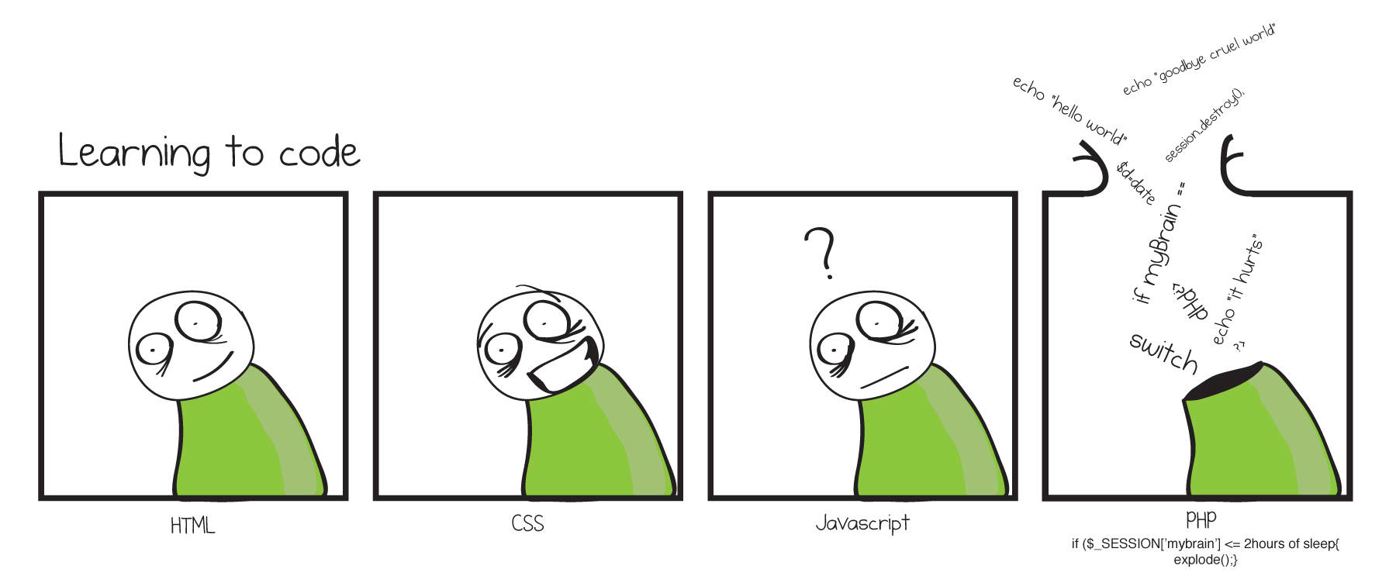
PHP Introduction
Data Types, Variables, Operators, Expressions, Conditional Statements
Svetlin Nakov
Technical Trainer
www.nakov.com
Software University
http://softuni.bg

Slide 2
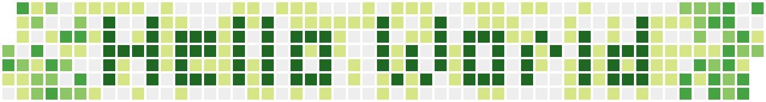

Table of Contents
Data Types in PHP
Integer, Floating-Point, Boolean, String
Declaring and Using Variables
Operators, Expressions, Statements
Conditional Statements
If-else, switch-case
False-like Conditions
Accessing Forms Fields

Slide 3

PHP Introduction

Slide 4

What is PHP?
PHP (PHP Hypertext Preprocessor) is server-side scripting language used for creating dynamic web content
First introduced in 1995 as module for Apache
Free and open-source, written in C
Can be deployed on almost any operating system
Provides interaction with Databases (CRUDs)
Can be embedded in HTML

Slide 5
PHP – Example
<html> <head> <title>My first PHP code!</title> </head> <?php
$myName = 'Yordan';
echo 'My name is ' + $myName;
?> <body> </body> </html>
Code is enclosed with <?php … ?>
tags

Slide 6
Mixing PHP and HTML
PHP is designed to mix HTML and PHP code:
This is similar to writing echo "Hello John!";
Very useful for long texts
<?php $name = "John"; ?>
<?php if ($name == "John") { ?>
<p>Hello John!</p>
<?php } else { ?>
<p>You are not John.</p>
<?php } ?>

Slide 7

Data Types in PHP

Slide 8
What Is a Data Type?
A data type:
Is a domain of values of similar characteristics
Defines the type of information stored in the computer memory (in a variable)
PHP supports eight types:
Scalar: Boolean, Integer, Floating point, String
Compound: Array, Object
resource and NULL
PHP is a "type-less" language

Slide 9
PHP Data Types
PHP is a typeless language
The variable types are not explicitly defined
The type of a variable can be changed at runtime
Variables in PHP are declared with the symbol $
$count = 5; // variable holds an integer value
$count = 'hello'; // the same variable now holds a string
$name = 'Svetlin Nakov'; // variable holds a string
$mark = 5.25; // mark holds a floating-point number

Slide 10

Integer Numbers
Integer types represent whole numbers
The size of an integer is platform-dependent
32-bit: -2147483647 to 2147483647
64-bit: -9223372036854775807 to 9223372036854775807
In Windows it is always 32-bit
Too large values for integer type are automatically turned into a floating-point number
$maxInteger = 2147483647;
echo gettype($maxInteger); // integer
$maxInteger += 1;
echo gettype($maxInteger); // double

Slide 11

Floating-Point Numbers
Floating-point types represent real numbers, e.g. 5.63
In PHP the floating-point numbers are 64-bit
Stored in the IEEE format
Have range from -1.79e+308 to 1.79e+308
Have precision of 15 digits
Can behave abnormally in the calculations
E.g. 0.1 + 0.2 = 0.30000000000000004

Slide 12
Numbers Conversion
Convert floating-point to integer number
Convert to integer number with rounding
Convert string to integer
$variable = 5;
$floatVar = floatval($variable);
// Or:
$floatVar = (float)$variable;
$variable = 5.24245;
$varInt = intval($variable);
// Or:
$varInt = (int)$variable;
$num = "3.14";
$int = (int)$num;
$float = (float)$num;

Slide 13

The Boolean Data Type
Has two possible values: true and false
Values are case-insensitive (True, true, TRUE & False, false, FALSE)
Is useful in logical expressions
Returns "1" or "null"
Example of Boolean variables:
echo(true); // 1
echo(false); // (nothing)
var_dump(true); // bool(true)
var_dump(false); // bool(false)

Slide 14
The String Data Type
The string data type represents a sequence of characters
Strings are enclosed in quotes:
Both ' and " work correctly, with “anomalies”
Best practices suggest using single quotes
Strings can be concatenated (joined together)
Using the . (dot) operator
$string = 'Welcome to PHP';
$name = 'Soft' . ' ' . 'Uni';

Slide 15
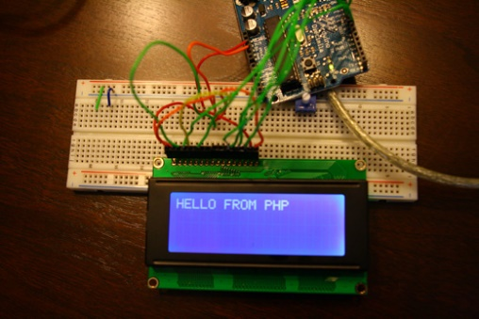
Variable Interpolation
Single-quoted strings do not interpolate variables:
Double-quoted string interpolate variables:
Curly braces ensures the correct variable is interpolated
$name = 'Fred';
echo 'Hello, $name'; // Hello, $name
$who = 'Svetlin';
$where = 'here';
echo "$who was $where"; // Svetlin was here
$n = 12;
echo "You are the {$n}th person";

Slide 16
Array Type
An array holds a group of values, which you can identify by position or identifying name
Arrays with number identifiers (with zero being the first position)
Associative arrays with string identifiers
$students[0] = "Dean";
$students[1] = "Vladislav";
$students = array("Dean", "Vladislav");
$students['Dean'] = 6;
$students['Vladislav'] = 5;
$students = array('Dean' => 6, 'Vladislav' => 5);

Slide 17
Object Type
A class is a definition of a structure
Contains properties (variables) and methods (functions)
Once a class is defined, any number of objects can be made from it with the new keyword
Object’s properties/methods can be accessed with the -> construct
class Person {
public $name = '';
function name ($newname) {
$this->name = $newname;
}
}
$svetlin = new Person;
$svetlin->name('Svetlin');
echo "Hello, {$svetlin->name}\n";

Slide 18
Resource Type
Special variable, holding a reference to an external resource
E.g. opened file, database connection, image canvas area
Resources are created and used by special functions.
Resource with no more references to it is detected automatically
It is freed by the garbage collector
is_resource() function checks whether a value is a resource
$res = database_connect(); // database connect function
database_query($res);
$res = "boo"; // database connection automatically closed because $res is redefined

Slide 19



Null Values
What is NULL in PHP?

Slide 20
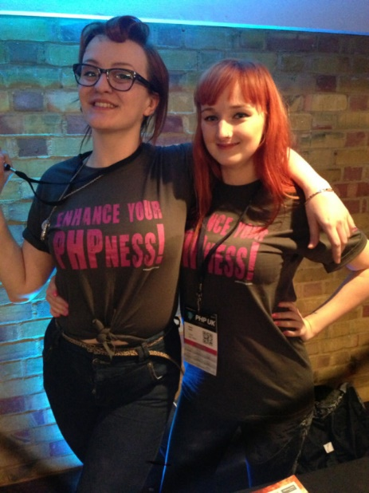
Null Value
In PHP there is a special value NULL
Undefined means that a variable is declared but not initialized
Null means that an object exists and is empty (has no value)
All variables can be reset to null with unset()
<?php $variable; // variable is undefined
$variable = 4; // variable has value 4
$variable = NULL; // variable has no value
unset($variable); // same
?>

Slide 21
Checking the Type of a Variable
The variable type can be checked with gettype()
Or just print it with var_dump()
Great for checking the type and value of a given variable in the code
$boolVariable = true;
gettype($boolVariable); // boolean
$intVariable = 123;
gettype($intVariable); // integer
$stringVariable = "SoftUni";
gettype($stringVariable); // string
$boolVariable = true;
var_dump($boolVariable);
// boolean(true)
$intVariable = 123;
var_dump($intVariable);
// integer(123)
$stringVariable = "SoftUni";
var_dump($stringVariable);
// string("SoftUni")

Slide 22

Data Types in PHP
Live Demo

Slide 23

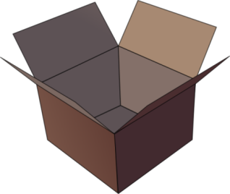
Declaring and Using Variables
p
q
i

Slide 24
What Is a Variable?
A variable is a:
Placeholder of information that can be changed at run-time
A piece of computer memory holding some value
Variables allow you to:
Store information
Retrieve the stored information
Change the stored information
p
q
i

Slide 25

Variable Characteristics
A variable has:
Name
Type (of stored data)
Value
Example:
Name: counter
Type: number
Value: 5
$counter = 5;

Slide 26
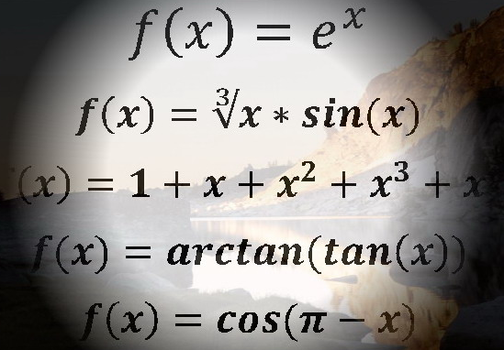
Declaring Variables
$
When declaring a variable we:
Specify its name (called identifier)
The type is inferred by the value
Give it an initial value
Example:
$
$
$height = 200;
$str = 'Hello';

Slide 27

Identifiers
Identifiers may consist of:
Letters , digits [0-9], underscore '_'
Cannot start with a digit
Cannot be a PHP keyword
Identifiers in PHP are case-sensitive
Identifiers should have a descriptive name
Only Latin letters
Variables and functions names: use camelCase

Slide 28
Identifiers – Examples
Examples of correct identifiers:
Examples of incorrect identifiers:
$New = 2; // Here N is capital, so it's not a PHP keyword
$_2Pac = 2; // This identifier begins with _
$поздрав = 'Hello'; // Unicode symbols used
$greeting = 'Hello'; // This is more appropriate
$n = 100; // Undescriptive
$number_of_clients = 100; // Descriptive
// Overdescriptive identifier:
$numberOfPrivateClientOfTheFirm = 100;
$new = 5; // new is a keyword
$2Pac = 2; // Cannot begin with a digit

Slide 29

Assigning Values
The = operator is used to assign a value to a variable:
// Assign a value to a variable
$firstValue = 5;
// Using an already declared variable:
$secondValue = $firstValue;
// Can’t write cascading inheritance like the example below
$thirdValue = $newValue = 3;

Slide 30
Variable Variables
Reference the value of a variable whose name is stored in another variable by prefacing the variable reference
After the second statement executes, the variable $first has the value "second"
// variable variables example
$variable = "first";
$$variable = "second";
echo $variable; // first
echo $first // second
echo $$variable // second

Slide 31

Variable References
References are how you create variable aliases
http://derickrethans.nl/talks/phparch-php-variables-article.pdf
$firstName = "Nakov";
$secondName =& firstName;
$secondName = "Karamfilov";
echo $firstName; // Karamfilov
echo $secondName; // Karamfilov

Slide 32
Variables in PHP
A variable in PHP can be:
undefined
NULL
Local
Example: In this code secondVar is unresolvable:
echo($asfd); // Error
$p = null; echo($p); // null
$localVar = 5; echo($localVar); // 5
$firstVar = 10;
echo($firstVar); // 10
echo($secondVar); // ReferenceError: secondVar doesn’t exist

Slide 33
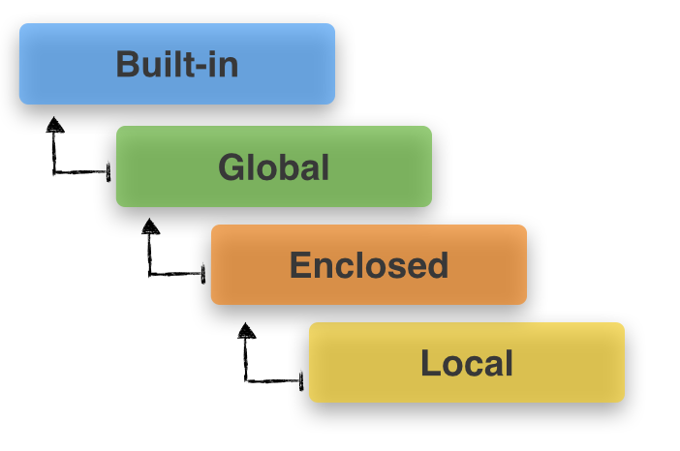
Variable Scope
Local, Global, Static

Slide 34
Local Scope
Local scope – a variable declared in a function is local to that function
visible only to code in that function
it is not accessible outside the function
variables defined outside a function (called global variables) are not accessible inside the function
Only functions can provide local scope
function updateCounter() {
$counter++;
}
$counter = 10;
updateCounter();
echo $counter; // 10

Slide 35
Global Scope
Variables declared outside a function are global
To allow a function to access a global variable, you can use the global keyword inside the function to declare the variable within the function
Can be accessed from any part of the program
Not available inside functions
Cumbersome way to update the global variable is to use PHP’s $GLOBALS: $GLOBALS[counter]
function updateCounter() {
global $counter;
$counter++; // or $GLOBALS[counter]++;
}
$counter = 10;
updateCounter();
echo $counter; // 11

Slide 36
Static Variables
Static variable retains its value between calls to a function
It is visible only within that function.
Declare a variable static with the static keyword
function updateCounter() {
static $counter = 0;
$counter++;
echo "Static counter: {$counter}\n";
}
$counter = 10;
updateCounter();
updateCounter();
echo "Global counter: {$counter}\n";
Output:
Static counter: 1
Static counter: 2
Global counter: 10

Slide 37
PHP Constants
In PHP constants are defined with the define function
Cannot change value
Doesn't start with $
Can hold any scalar value
<?php define("CONSTANT", "Hello world."); echo CONSTANT; // outputs "Hello world." define("GREETING", "Hello you.", true); // not recommended echo GREETING; // outputs "Hello you." echo Greeting; // outputs "Hello you." ?>

Slide 38


Operators in PHP
Arithmetic, Logical, Comparison, Assignment, …

Slide 39
What is an Operator?
Operator is an operation performed over data at runtime
Takes one or more arguments (operands)
Produces a new value
Operators have precedence
Precedence defines which will be evaluated first
Operators are used to build expressions
Expressions are sequences of operators and operands that are evaluated to a single value

Slide 40
Categories of Operators in PHP
Category | Operators
Arithmetic | + - * / % ++ --
Logical | && || ^ !
Binary | & | ^ ~ << >>
Comparison | == != < > <= >= === !==
Assignment | = += -= *= /= %= &= |= ^= <<= >>=
String concatenation | +
Other | . [] () ?: new

Slide 41
Operators Precedence
Precedence | Operators
Highest | ()
 | ++ -- (postfix) new typeof
 | ++ -- (prefix) + - (unary) !
 | * / %
 | + -
 | << >>
 | < > <= >= is as
 | == !=
Lower | &

Slide 42
Operators Precedence (2)
Precedence | Operators
Higher | ^
 | |
 | &&
 | ||
 | ?:
Lowest | = *= /= %= += -= <<= >>= &= ^= |=
Parenthesis operator always has the highest precedence
Note: prefer using parentheses, even when it seems stupid to do so

Slide 43
Arithmetic Operators
Arithmetic operators +, -, *, / are the same as in math
The division operator / returns number or NaN
Remainder operator % returns the remainder from division of numbers
Even on real (floating-point) numbers
E.g. 5.3 % 3 → 2.3
The operator ++ / -- increments / decrement a variable
Prefix ++ vs. postfix ++

Slide 44
Logical Operators
Logical operators take boolean operands and return boolean result
Operator ! turns true to false and false to true
Behavior of the operators &&, || and ^ (1 == true, 0 == false):
Operation | || | || | || | || | && | && | && | && | ^ | ^ | ^ | ^
Operand1 | 0 | 0 | 1 | 1 | 0 | 0 | 1 | 1 | 0 | 0 | 1 | 1
Operand2 | 0 | 1 | 0 | 1 | 0 | 1 | 0 | 1 | 0 | 1 | 0 | 1
Result | 0 | 1 | 1 | 1 | 0 | 0 | 0 | 1 | 0 | 1 | 1 | 0

Slide 45
Bitwise Operators
Bitwise operators in PHP always work for 32-bit integers
Bitwise operator ~ turns all 0 to 1 and all 1 to 0
Like ! for boolean expressions but works bit by bit
The operators |, & and ^ behave like bitwise ||, && and ^
The << and >> move the bits (left or right)
Behavior of the operators |, & and ^:
Operation | | | | | | | | | & | & | & | & | ^ | ^ | ^ | ^
Operand1 | 0 | 0 | 1 | 1 | 0 | 0 | 1 | 1 | 0 | 0 | 1 | 1
Operand2 | 0 | 1 | 0 | 1 | 0 | 1 | 0 | 1 | 0 | 1 | 0 | 1
Result | 0 | 1 | 1 | 1 | 0 | 0 | 0 | 1 | 0 | 1 | 1 | 0

Slide 46
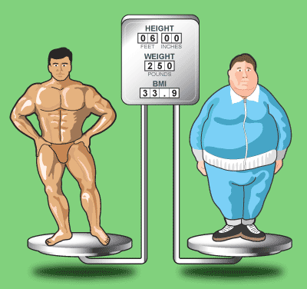
Comparison Operators
Comparison operators are used to compare variables
==, <, >, >=, <=, !=, ===, !==
The == means "equal after type conversion"
The === means "equal and of the same type"
$a = 5;
$b = 4;
var_dump($a >= $b); // bool(true)
var_dump($a != $b); // bool(true)
var_dump($a == $b); // bool(false)
var_dump($a == "5"); // bool(true)
var_dump($a === "5"); // bool(false)

Slide 47
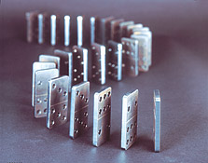
Assignment Operators
Assignment operators are used to assign a value to a variable
=, +=, -=, |=, ...
Assignment operators example:
$x = 6;
$y = 4;
echo($y *= 2); // 8
$z = $y = 3; // Error
echo(z); // 3
echo($x |= 1); // 7
echo($x += 3); // 10
echo($x /= 2); // 5

Slide 48
Other Operators
String concatenation operator . is used to concatenate strings
If the second operand is not a string, it is converted to string automatically
Member access operator . is used to access object members
Square brackets [] are used with arrays to access element by index
Parentheses () are used to override the default operator precedence
$output = "The number is : ";
$number = 5;
echo($output . $number);
// The number is : 5

Slide 49
Other Operators (2)
Conditional operator ?: has the form:
If b is true then the result is x, else the result is y
Also called ternary operator
The new operator is used to create new objects
this operator references the current context
$b ? $x : $y

Slide 50

Other Operators (3)
$a = 6;
$b = 4;
echo($a > $b ? "a > b" : "b >= a"); // a > b
echo "SoftUni" == "SoftUni" ? "Equal" : "Not Equal";
$c = $b = 3; // b = 3; followed by c = 3;
echo($c); // 3
echo(($a + $b) / 2); // 4.5
echo(gettype($a)); // integer
echo(gettype([])); // array

Slide 51

Operators in PHP
Live Demo

Slide 52

Expressions

Slide 53
Expressions
Expressions are:
Sequences of operators, literals and variables that are evaluated to some value
Examples:
$r = (150 - 20) / 2 + 5; // r = 70
// Expression for calculation of circle area
$surface = pi() * $r * $r;
// Expression for calculation of circle perimeter
$perimeter = 2 * pi() * $r;

Slide 54
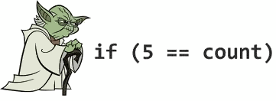
If and If-else
Implementing Conditional Logic

Slide 55
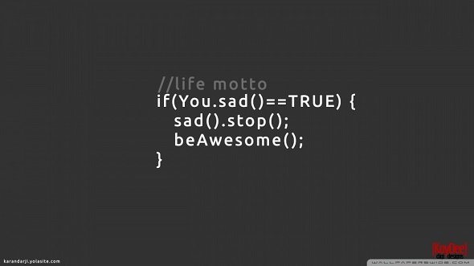
Conditional Statements: if-else
PHP implements the classical if / if-else statements:
$number = 5;
if ($number % 2 == 0) {
echo("This number is even.");
}
else {
echo("This number is odd.");
}

Slide 56
Alternative If Syntax
PHP offers an alternative syntax for the if-statement:
<?php
$a == 5;
if ($a == 5):
echo "a equals 5";
echo "...";
elseif ($a == 6):
echo "a equals 6";
echo "!!!";
else:
echo "a is neither 5 nor 6";
endif;
?>

Slide 57

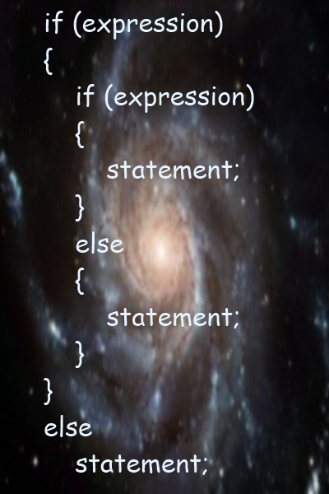
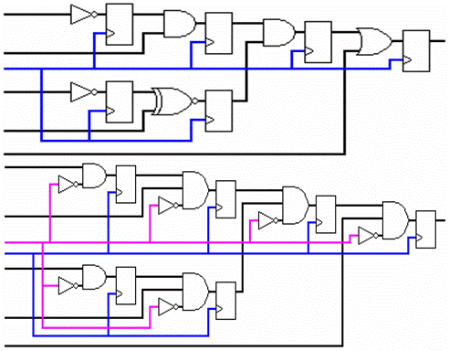
if and if-else
Live Demo

Slide 58

switch-case
Making Several Comparisons at Once

Slide 59
The switch-case Statement
Selects for execution a statement from a list depending on the value of the switch expression
switch ($day) {
case 1: echo('Monday'); break;
case 2: echo('Tuesday'); break;
case 3: echo('Wednesday'); break;
case 4: echo('Thursday'); break;
case 5: echo('Friday'); break;
case 6: echo('Saturday'); break;
case 7: echo('Sunday'); break;
default: echo('Error!'); break;
}

Slide 60
How switch-case Works?
The expression is evaluated
When one of the constants specified in a case label is equal to the expression:
The statement that corresponds to that case is executed
If no case is equal to the expression:
If there is default case, it is executed
Otherwise the control is transferred to the end point of the switch statement
The break statement exits the switch-case statement

Slide 61
Alternative Switch Syntax
PHP offers an alternative syntax for switch constructs:
$variable = 2;
switch ($variable):
case 1:
echo "<div>News</div>";
break;
case 2:
echo "<div>Forum</div>";
break;
endswitch;

Slide 62
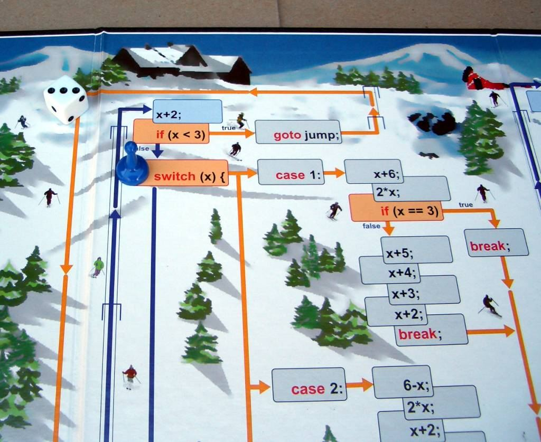
The switch-case Statement
Live Demo

Slide 63

Accessing Form Fields from PHP
Reading and Writing Form Data

Slide 64
Accessing Forms Fields
You can access the form fields by their name property
HMTL:
PHP:
<form action="TakePostRequest.php" method="get">
Name: <input type="text" name="name"><br>
E-mail: <input type="text" name="email"><br>
<input type="submit">
</form>
Welcome <?php echo htmlentities($_GET["name"]) ?><br>
Your email is: <?php echo htmlentities($_GET["email"]) ?>

Slide 65
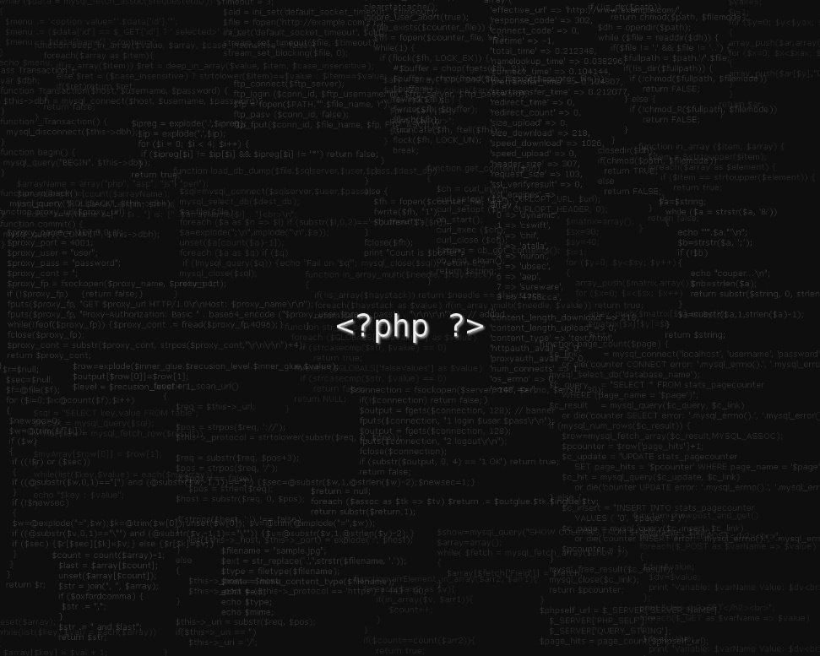
Accessing Form Fields
Live Demo

Slide 66


Summary
PHP dynamic data types
Number, String, Boolean, Null
Operators (same as in C#, Java and C++)
Expressions (same as in C#, Java and C++)
If-else statements (same as in C#, Java and C++)
Switch-case statement (similar to Java / C#)
False-like Conditions
Accessing Form Fields
PHP Basics

Slide 67
PHP Syntax
https://softuni.bg/trainings/coursesinstances/details/5

Slide 68
License
This course (slides, examples, demos, videos, homework, etc.) is licensed under the "Creative Commons Attribution-NonCommercial-ShareAlike 4.0 International" license

Slide 69




Free Trainings @ Software University
Software University Foundation – softuni.org
Software University – High-Quality Education, Profession and Job for Software Developers
softuni.bg
Software University @ Facebook
facebook.com/SoftwareUniversity
Software University @ YouTube
youtube.com/SoftwareUniversity
Software University Forums – forum.softuni.bg

